Slide 1
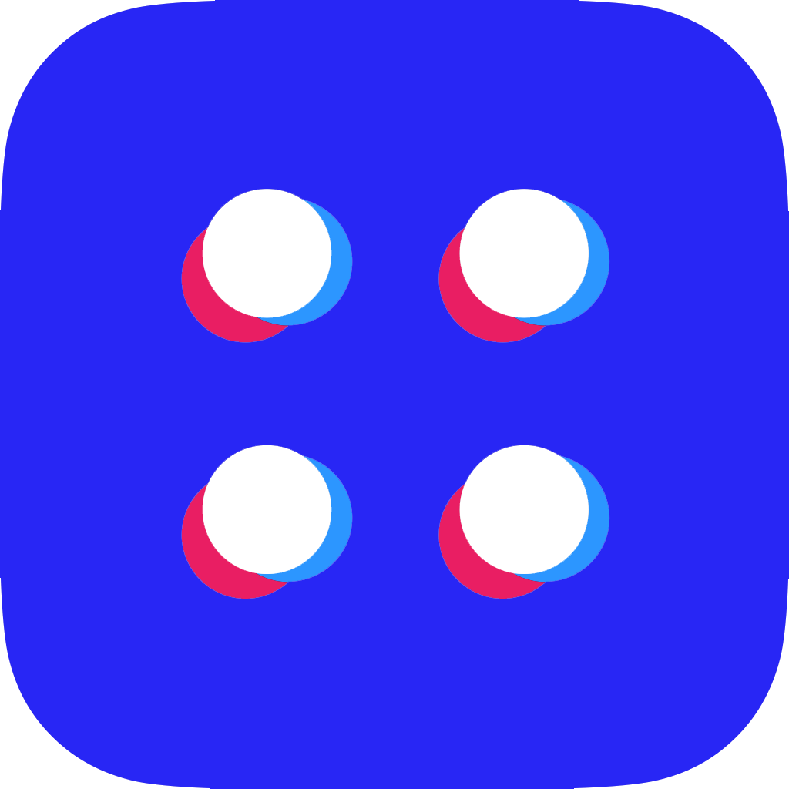
INTERNET OF TRUST BLOCKSTACK Paris, 13 Nov 2018
Friedger Müffke
blockstack:friedger.id
https://friedger.de

Slide 2
DO YOU
OWN YOUR
DATA?
THE PROBLEM

Slide 3
The INTERNET didn’t
turned out as we hope
Honey pots
And
3rd party hack
Platform
Lock in
Tracking
and Data
Harvesting
Creation of
monopolies
Invasive Ads

Slide 4
INTRODUCING BLOCKSTACK - YOUR NEW INTERNET

Slide 5
Share slide deck privately with you

Slide 6
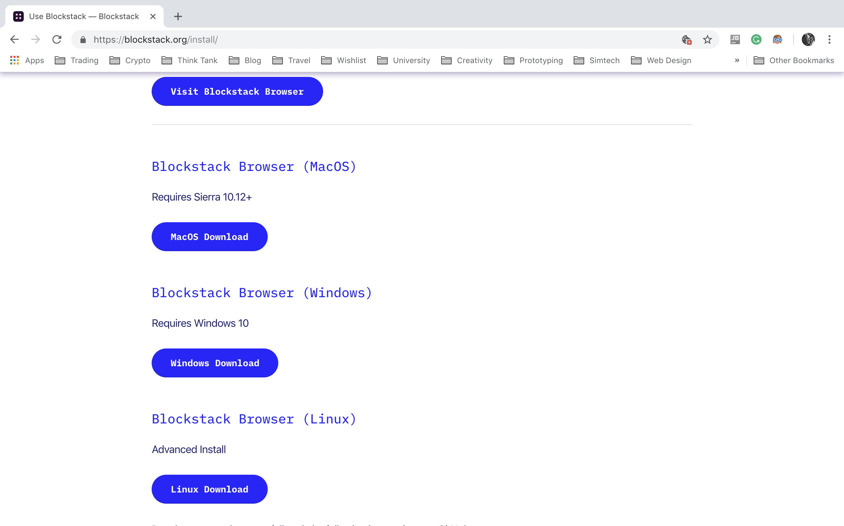
1. Go to https://blockstack.org/install - download or use the blockstack browser

Slide 7
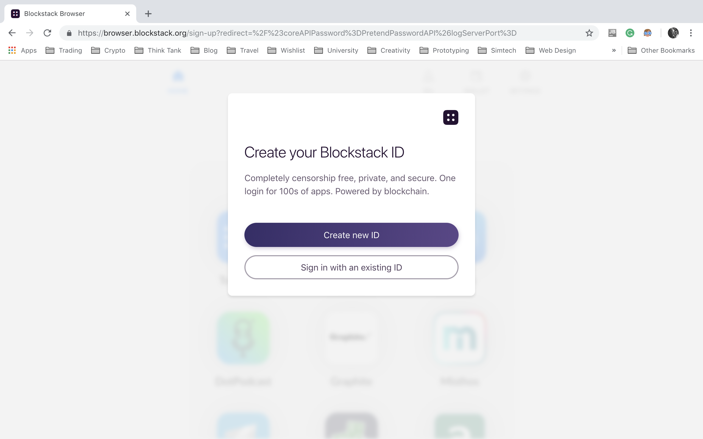
2. Create your username

Slide 8
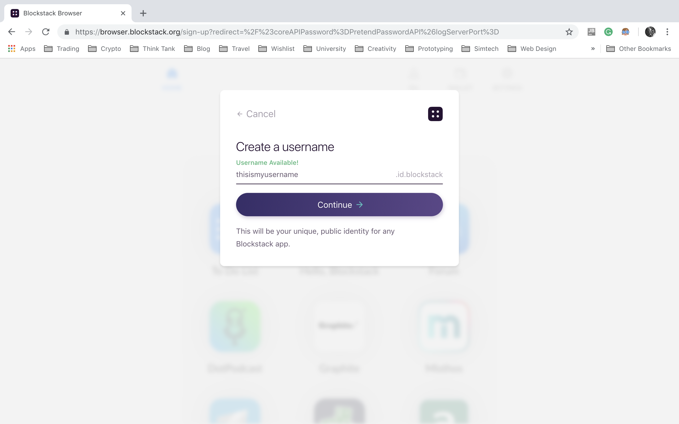
3. Check Availability

Slide 9
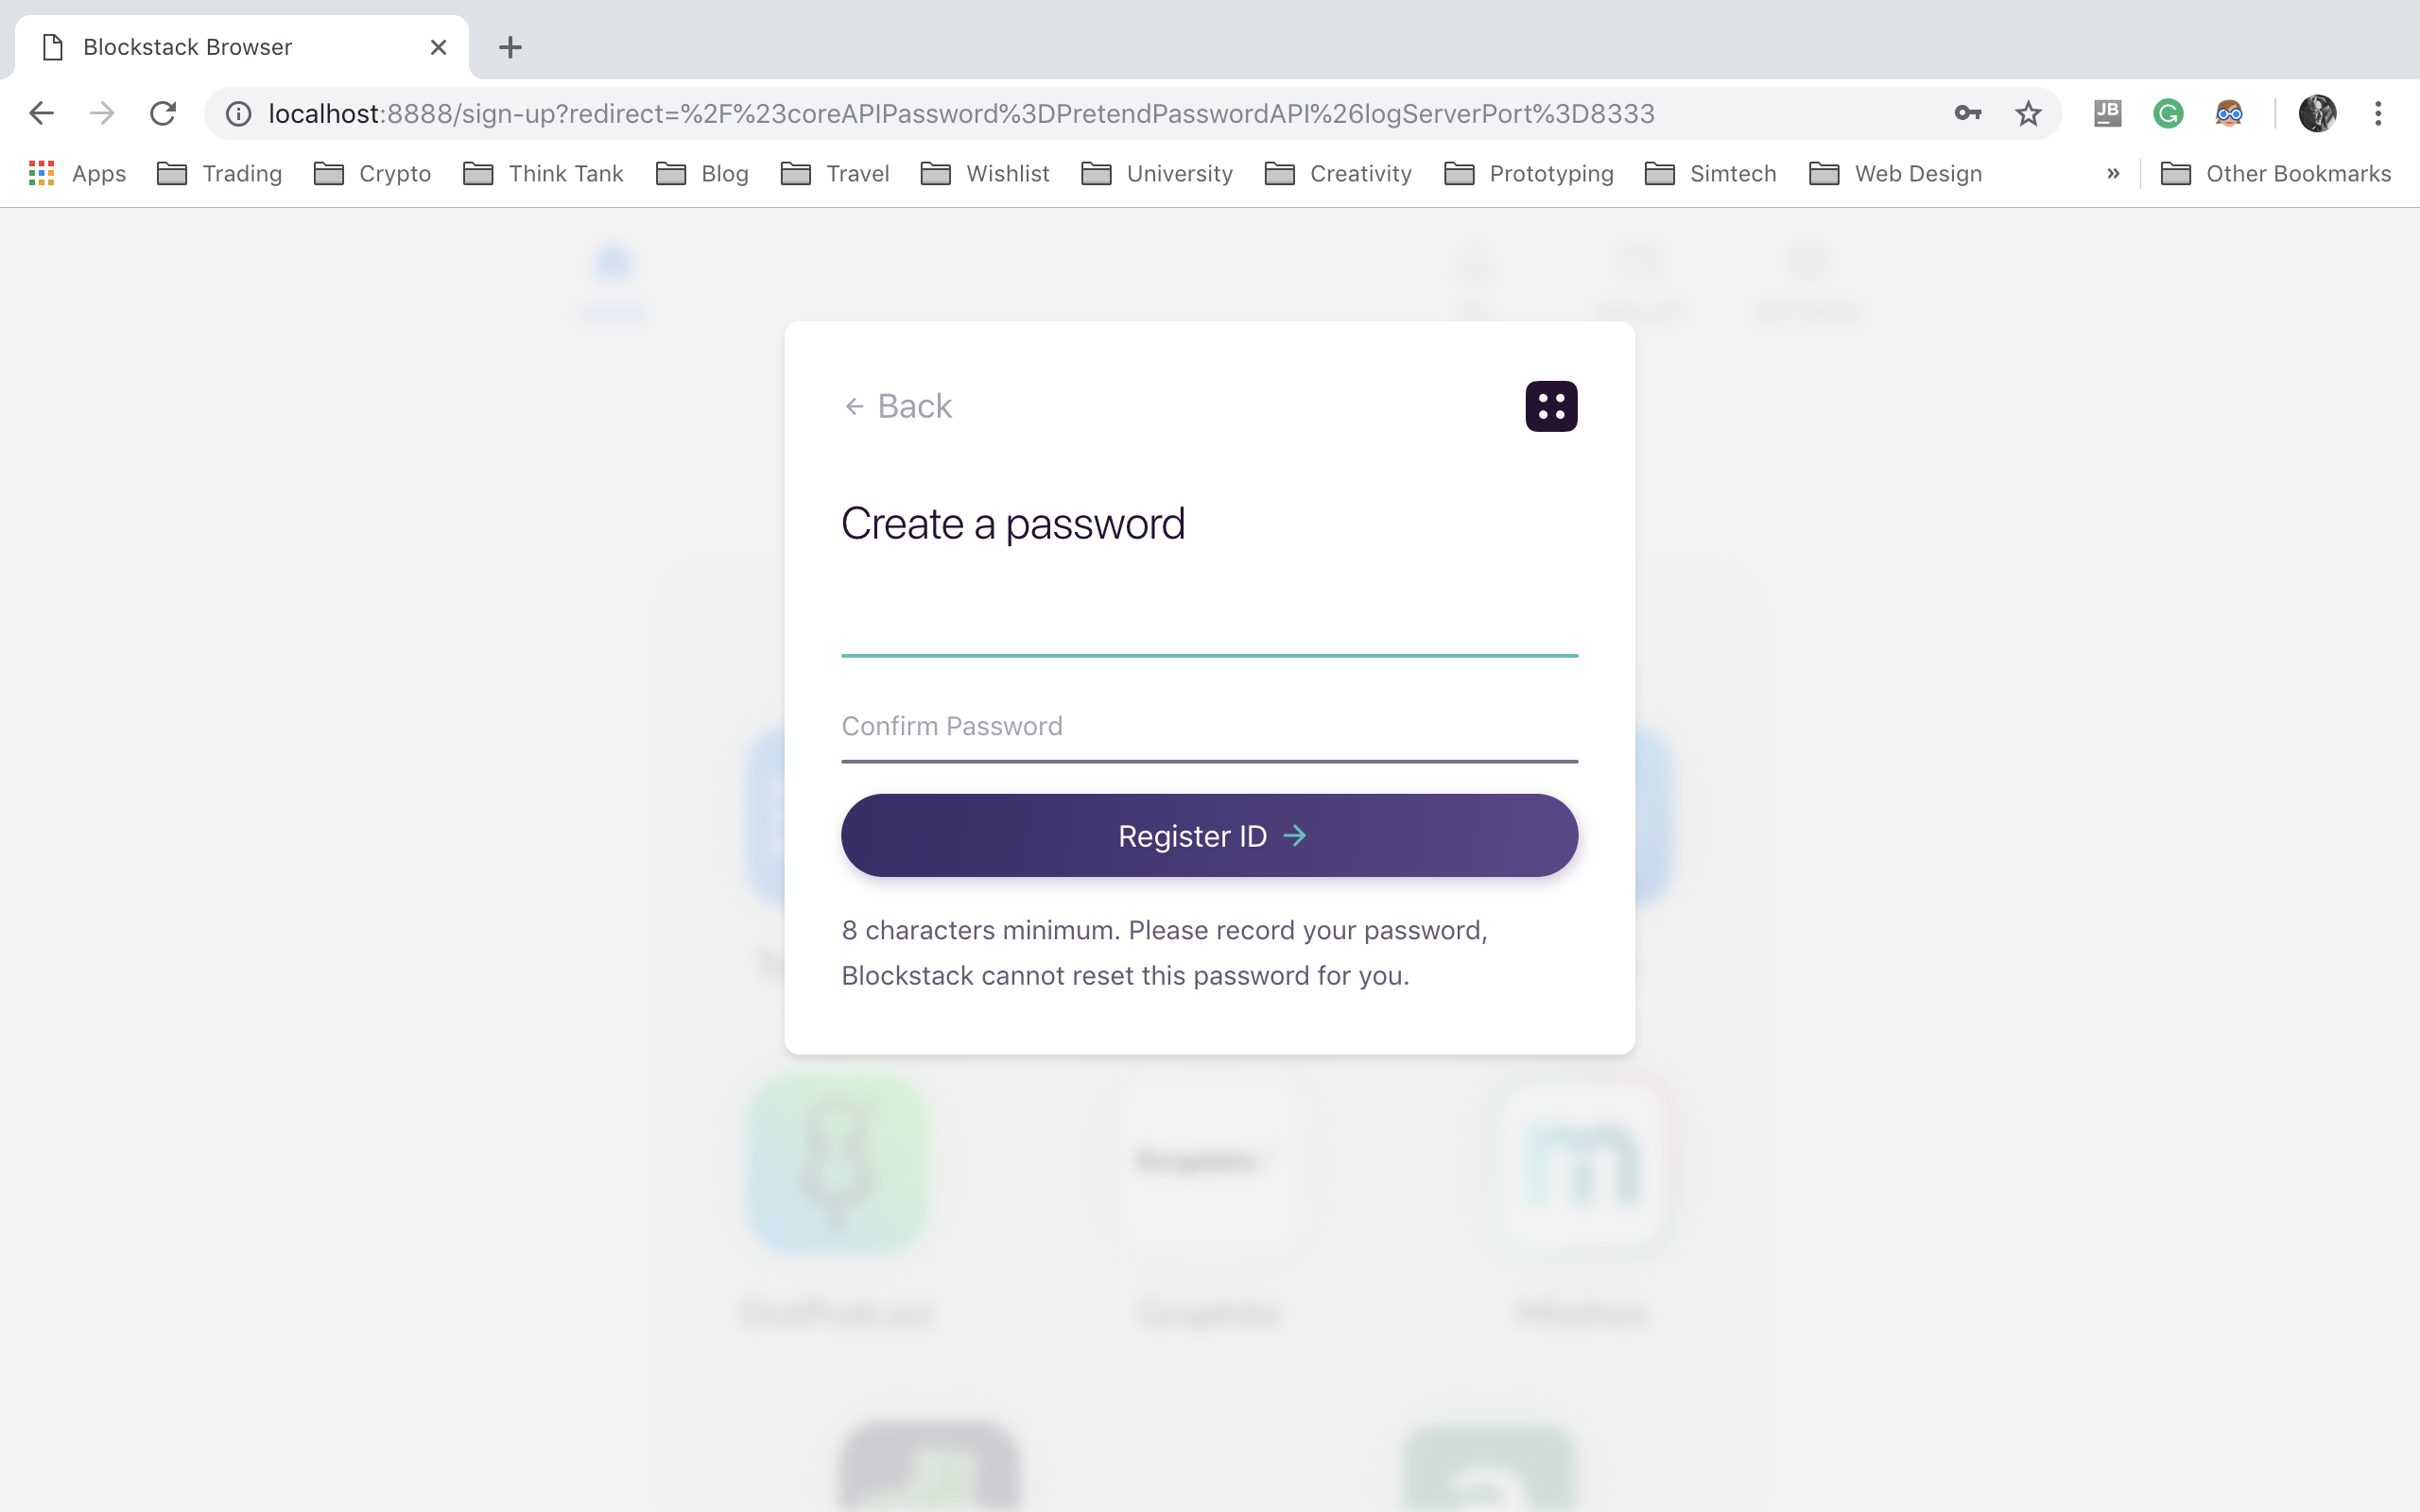
3. Set Password

Slide 10
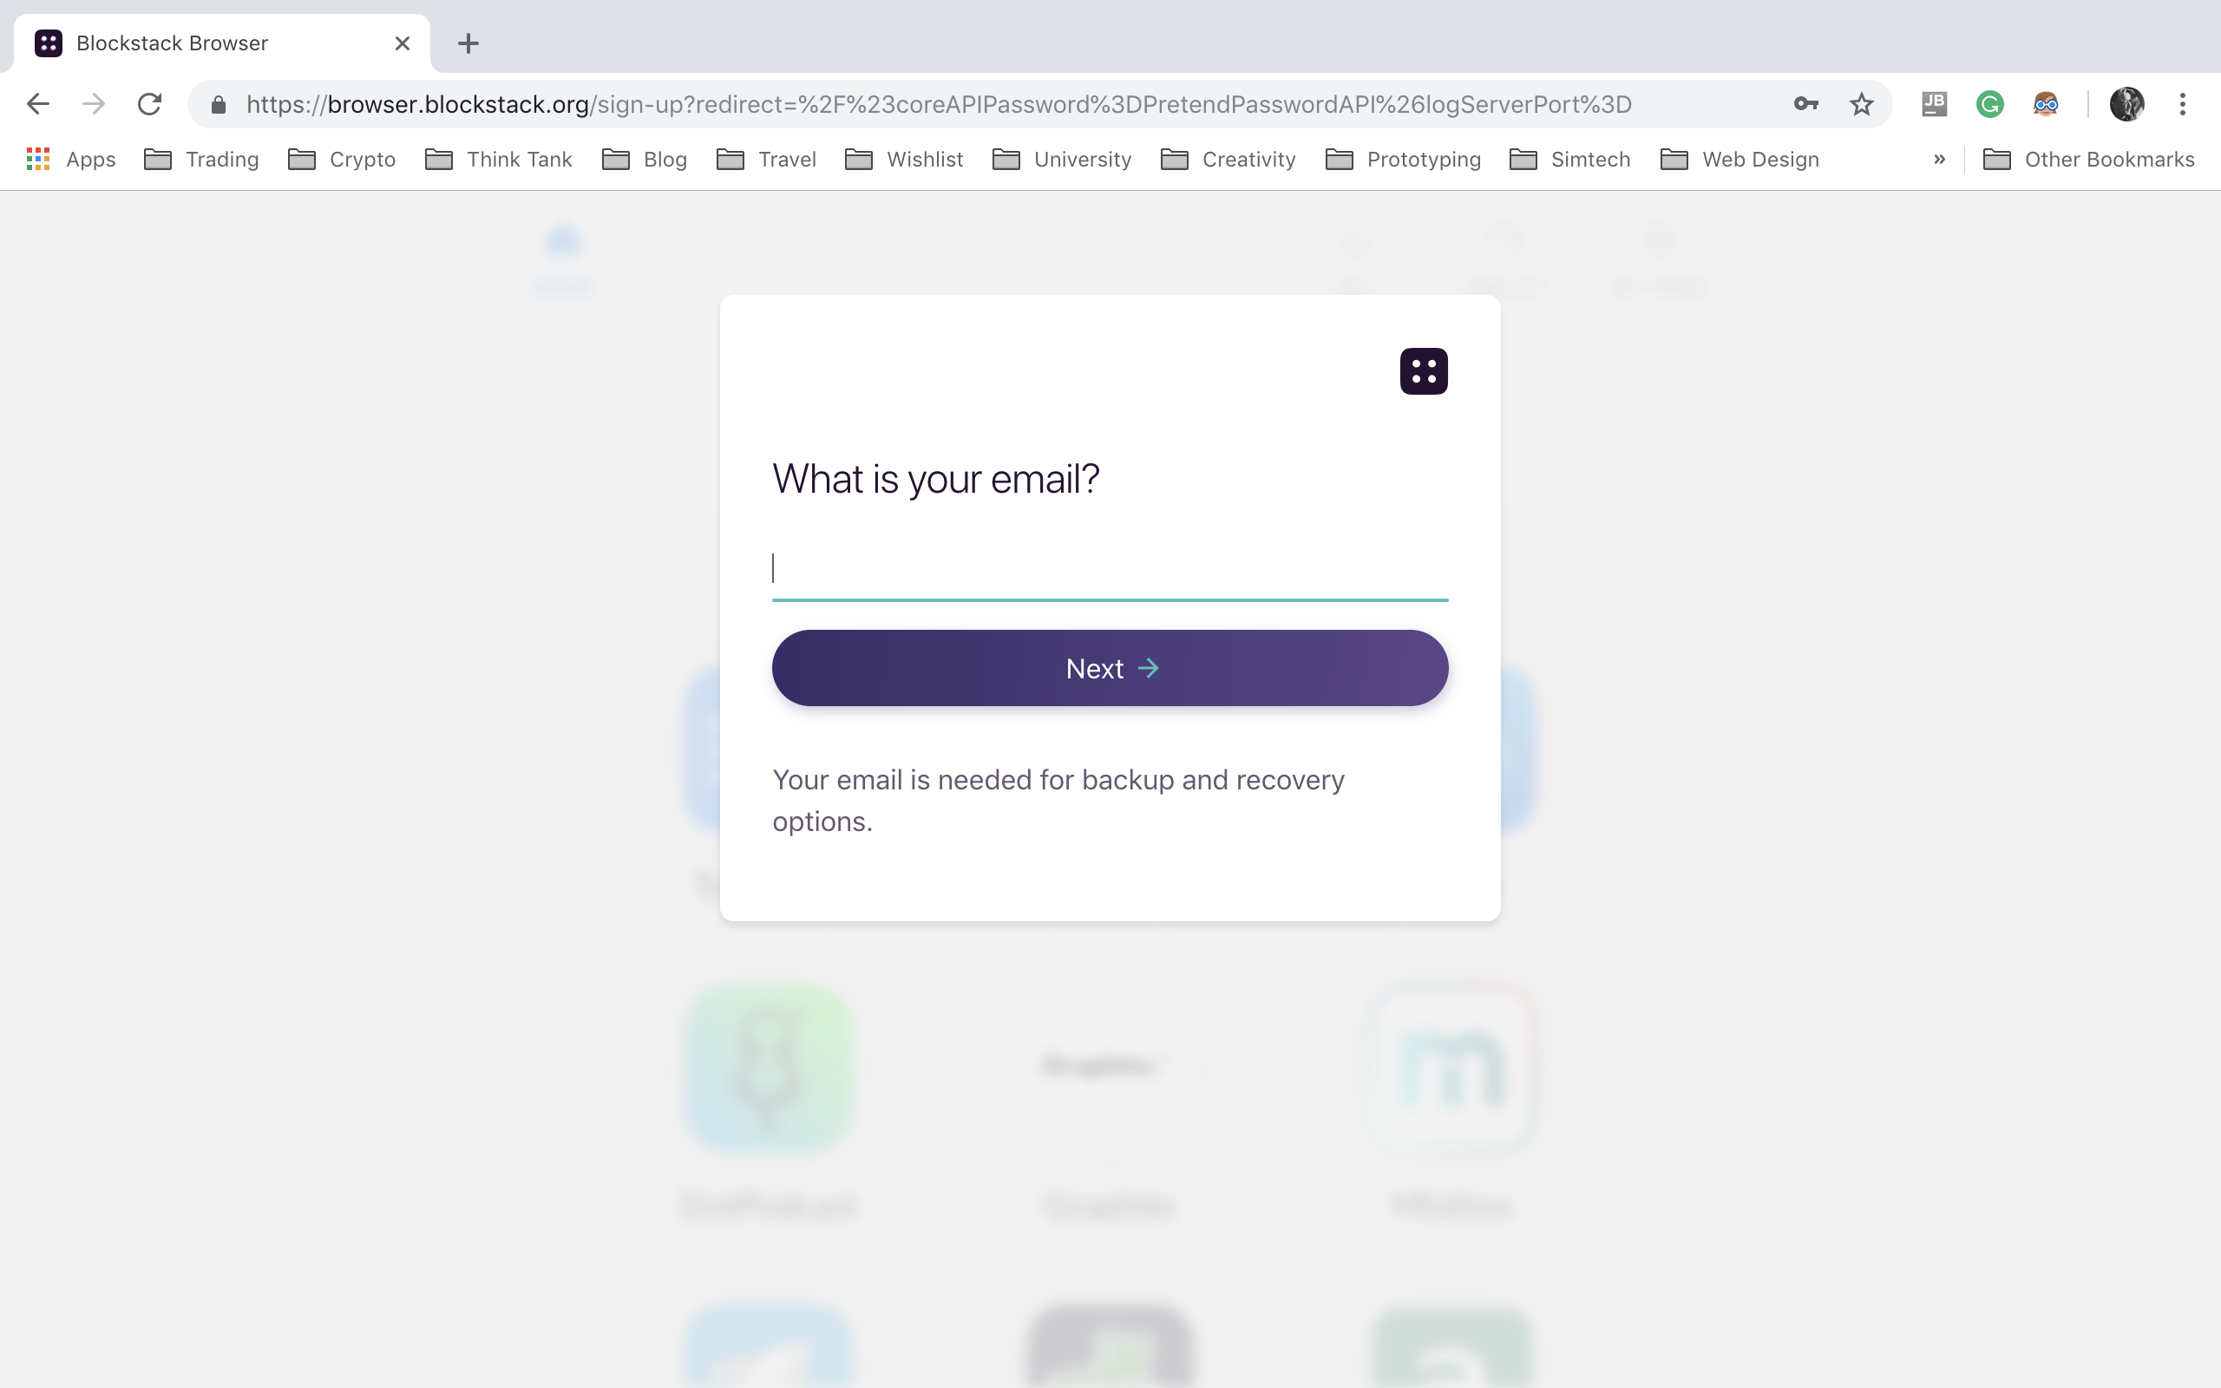
4. Enter email

Slide 11
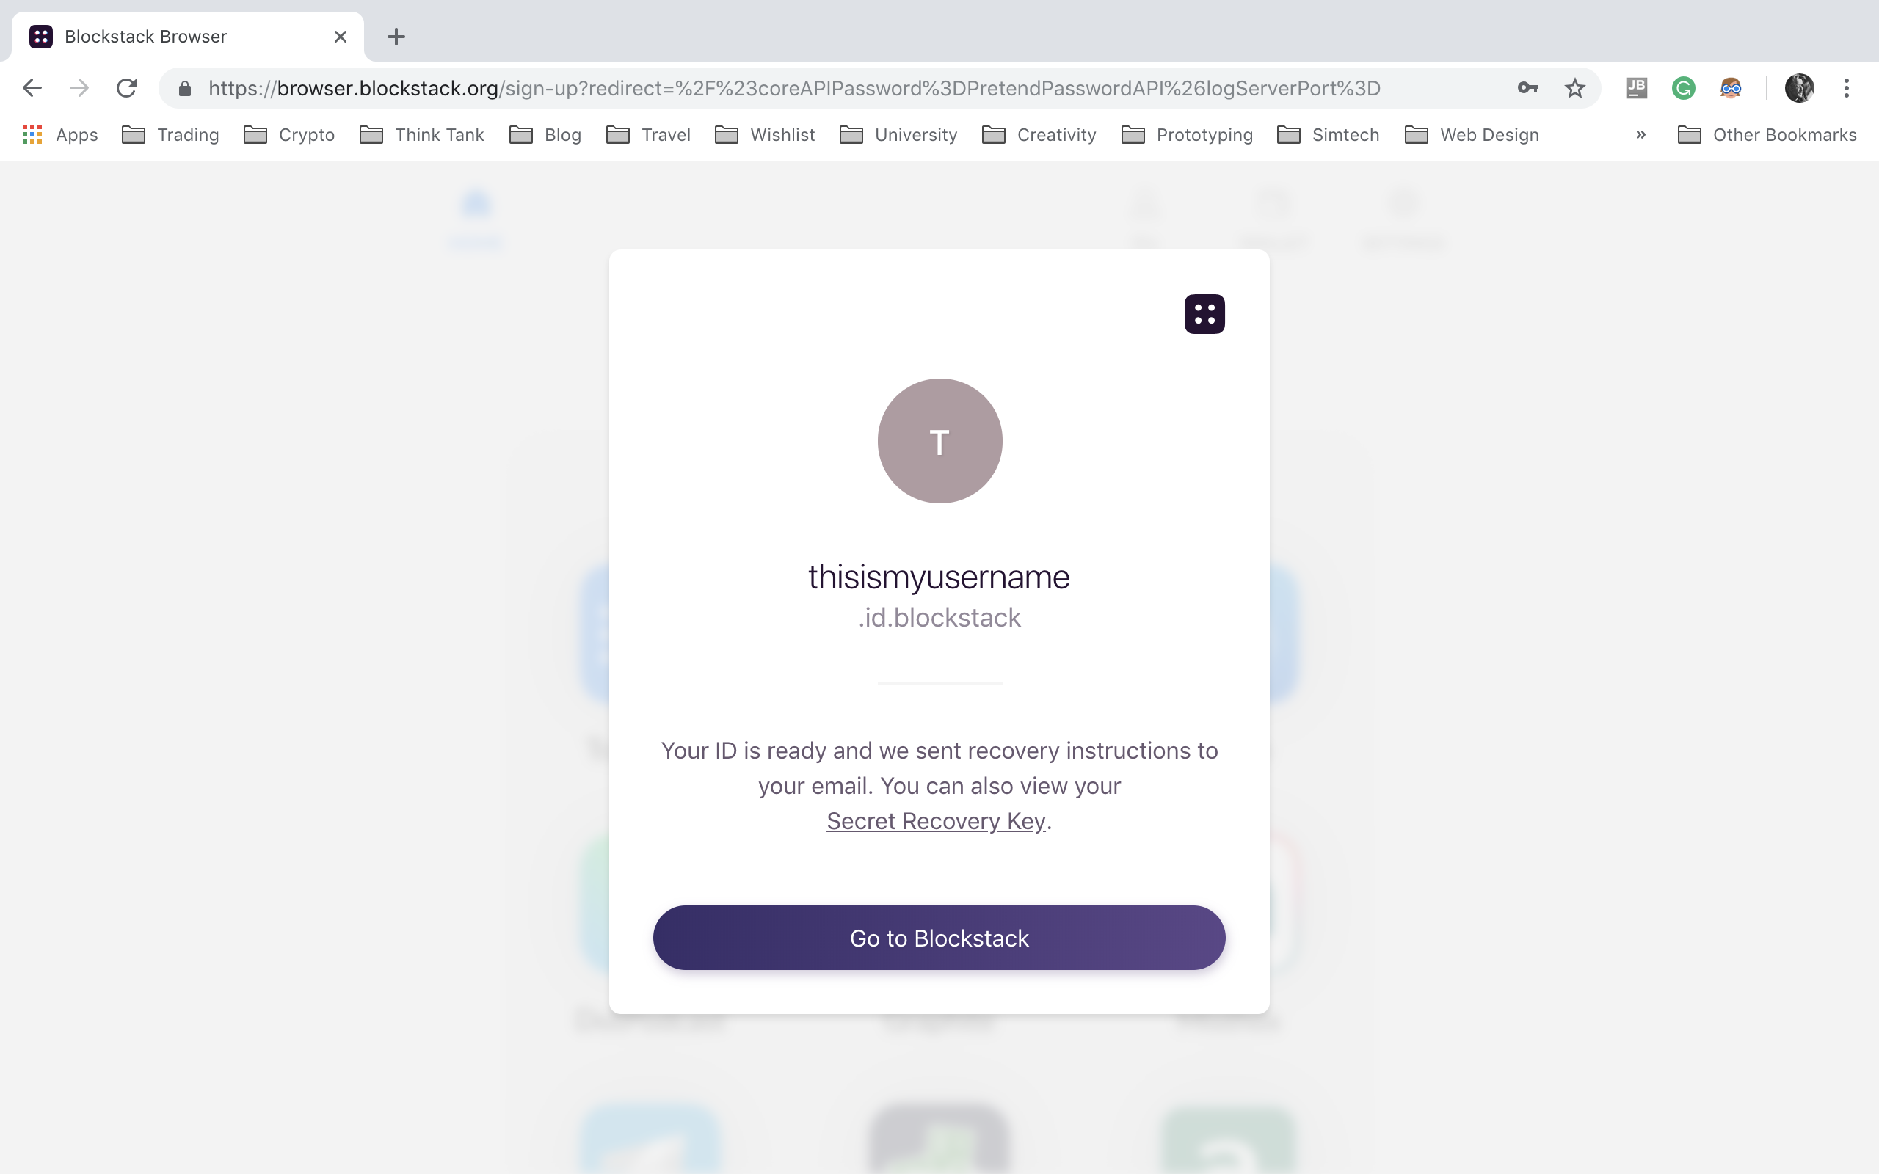
5. ID ready

Slide 12
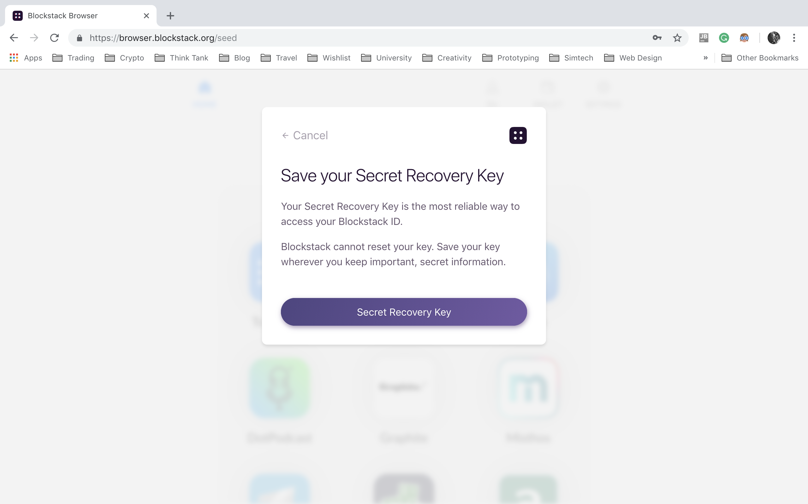
6. Double Back up - Don't forget to save your secret recovery key.

Slide 13
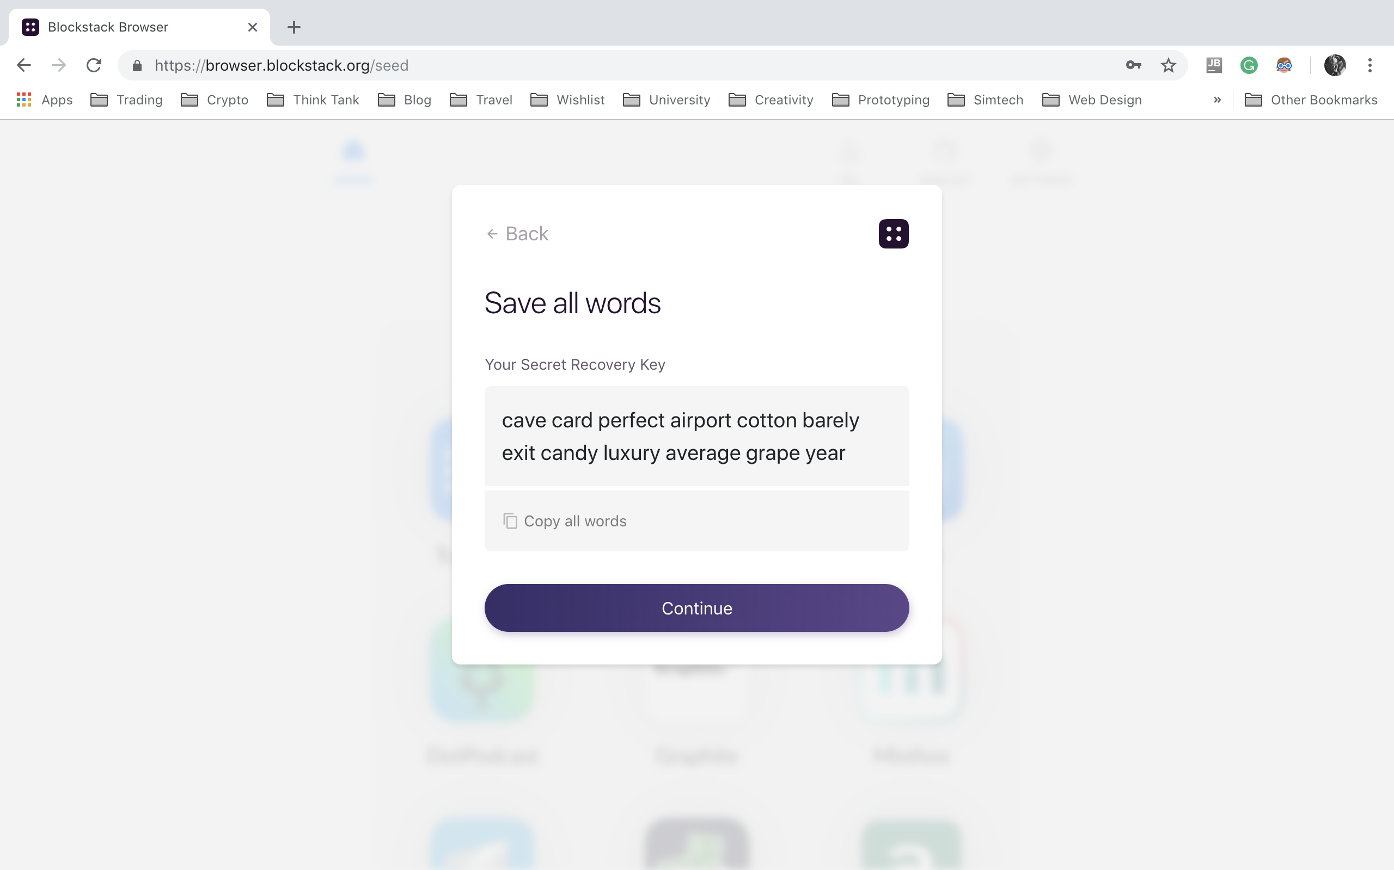
7. Write it down and store it in a safe place (highly confidential)

Slide 14
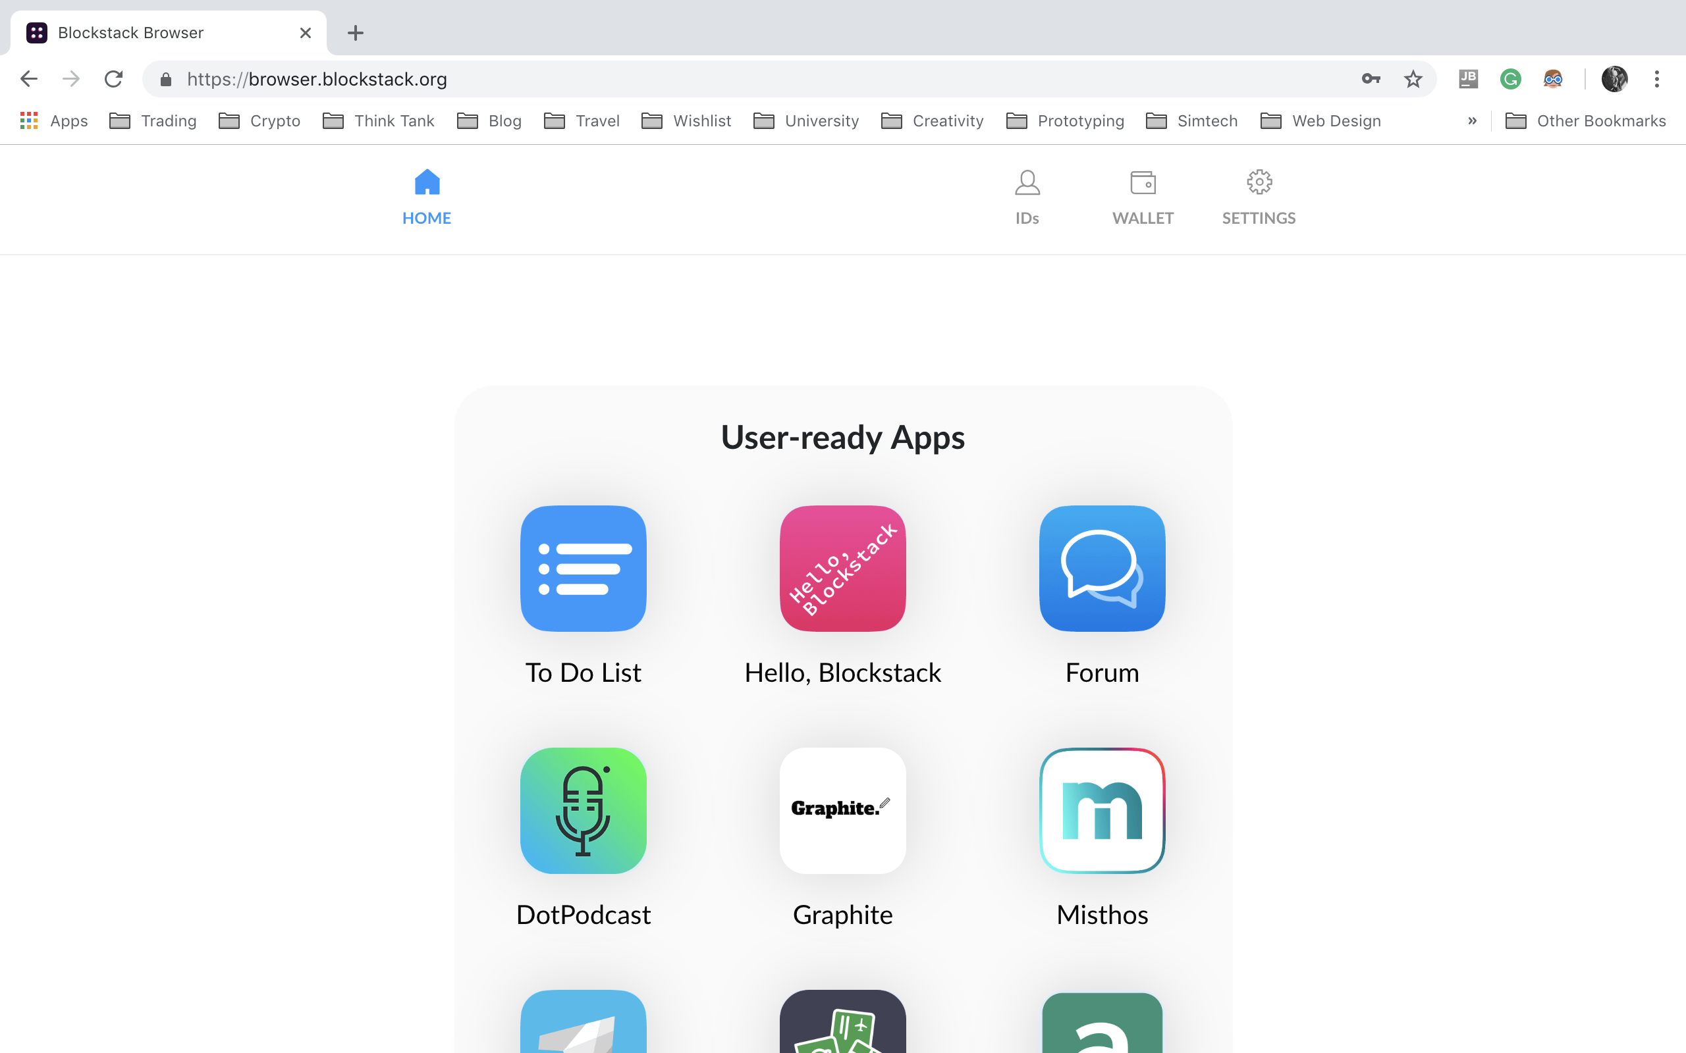
8. Welcome to the New Internet

Slide 15
USING APPLICATIONS

Slide 16
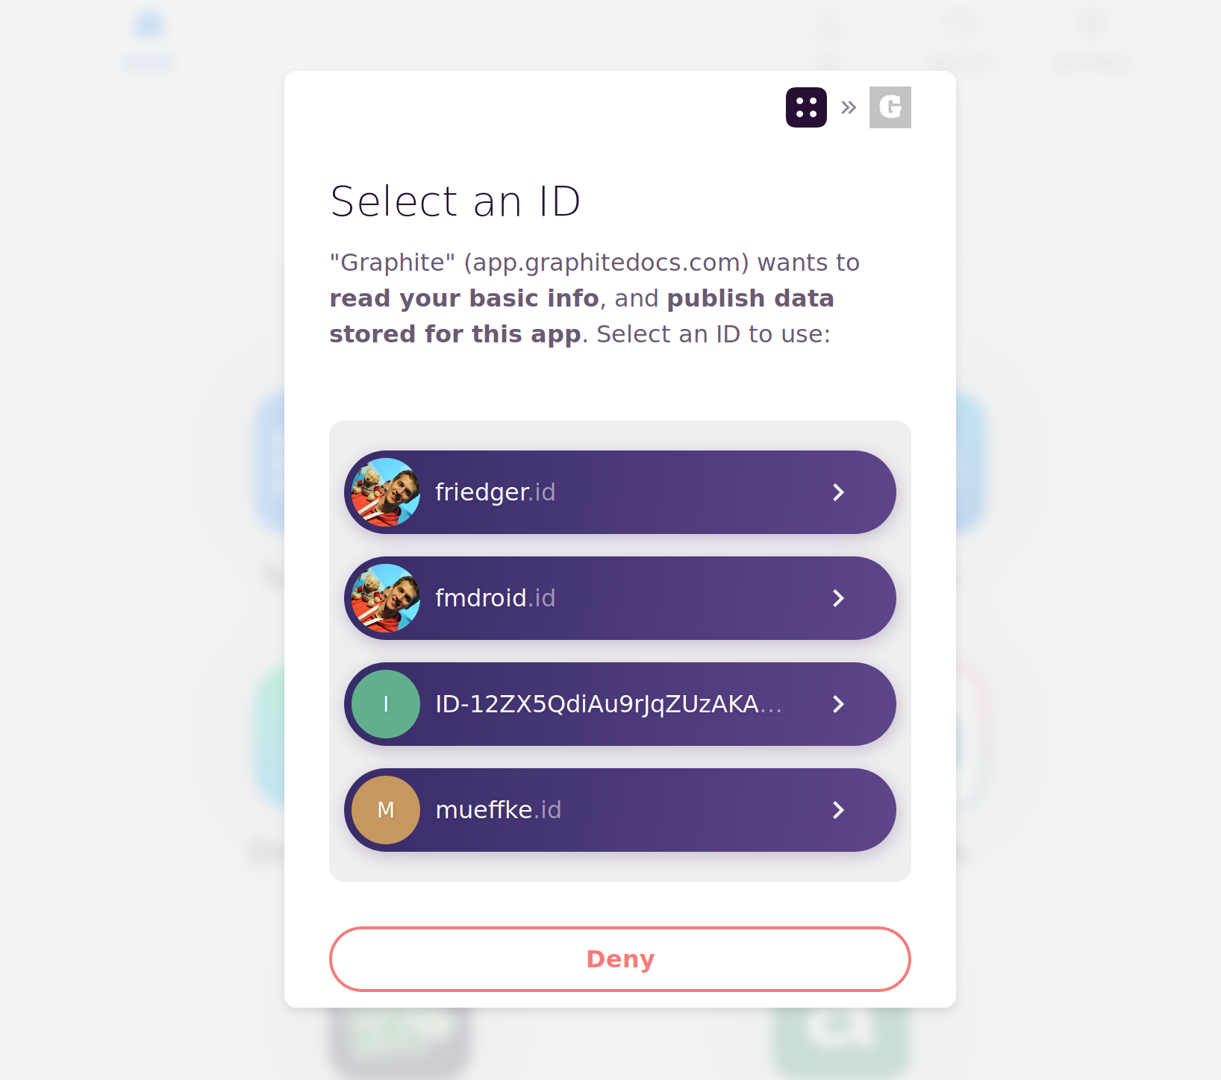
1. Sign In + Confirm Permissions

Slide 17
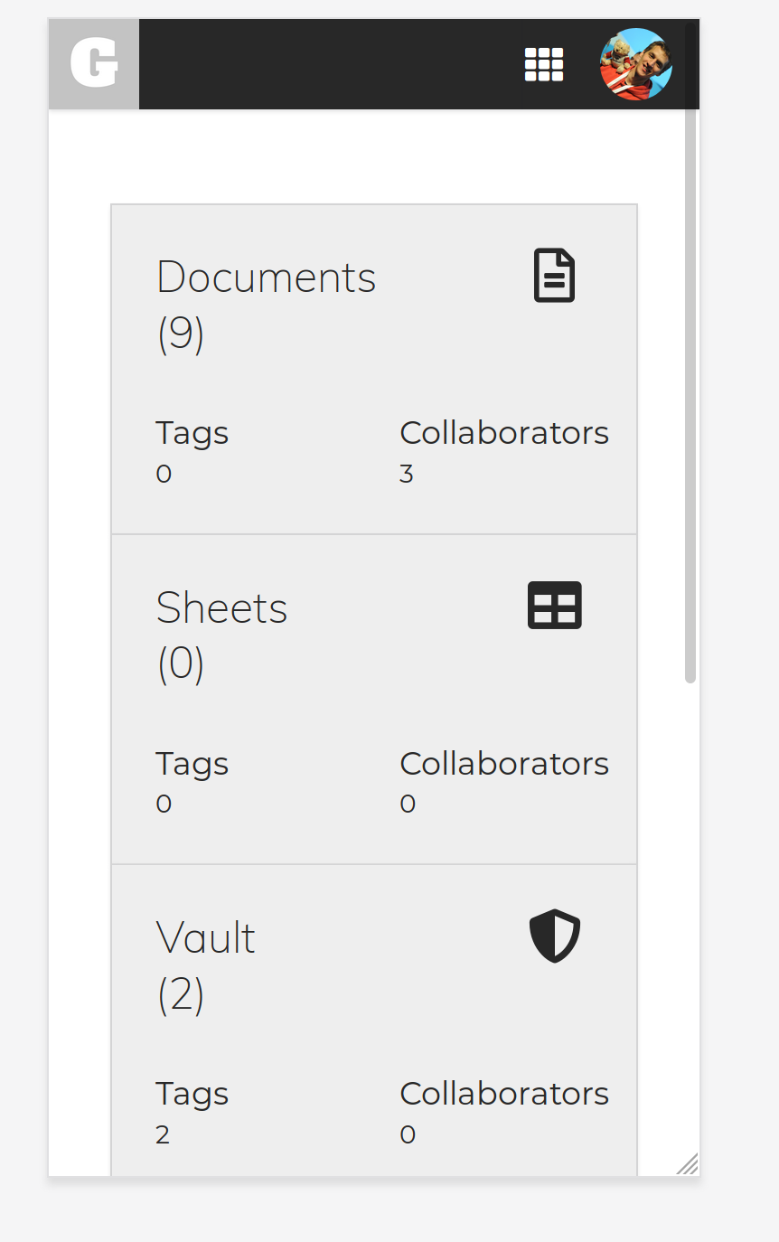
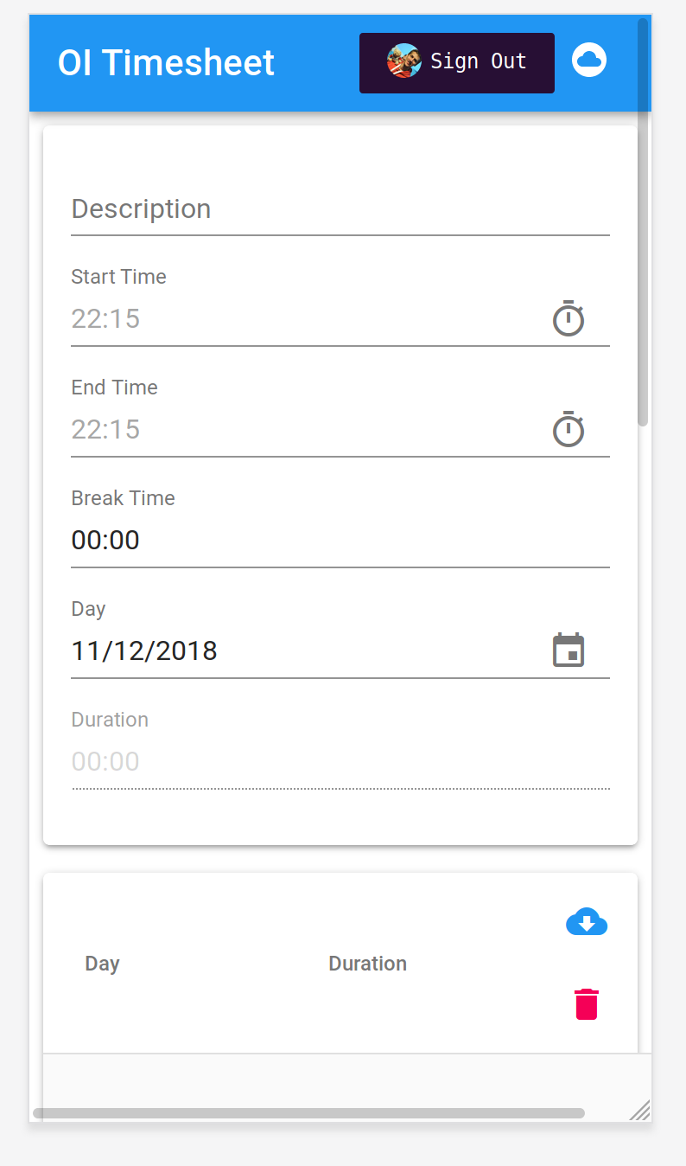
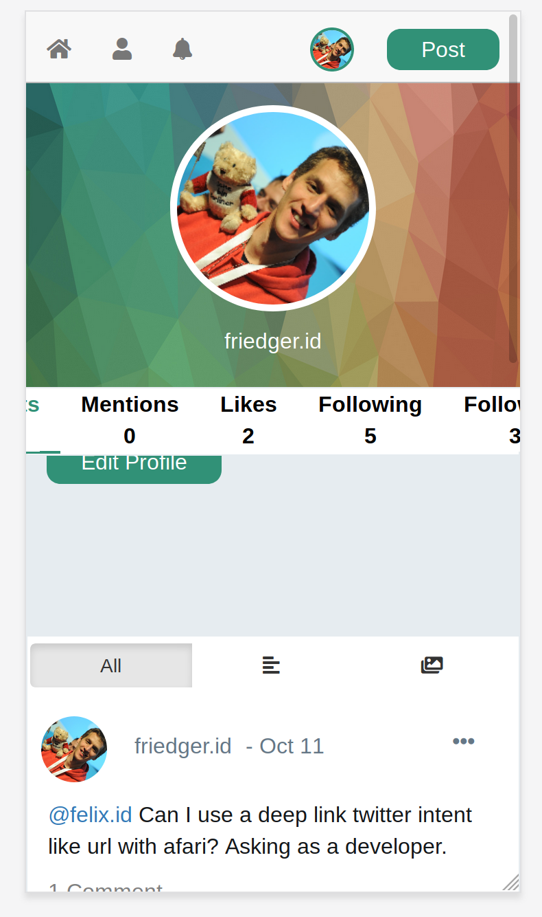
2. Use the apps

Slide 18
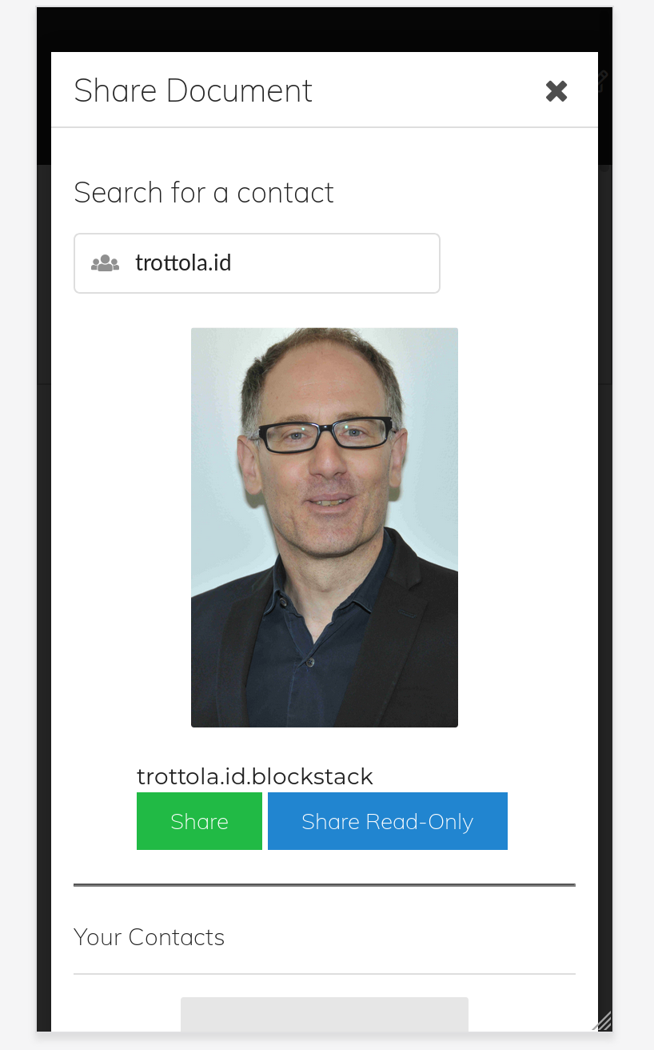
3. Share file privately

Slide 19
friedger.id trottola.id.blockstack

Slide 20
BLOCKSTACK NAMING SERVICE

Slide 21
BNS
Virtual blockchains
Fast Reads
Needs cryptocurrency for write

Slide 22
Where is my file storage (friedger.id) Where is the public key for trottola.id.blockstack

Slide 23
ATLAS NETWORK

Slide 24
ATLAS
P2P Network
Zone Files
Off-chain storage
For BNS
100% replicated

Slide 25
Store an encrypted copy!

Slide 26
GAIA STORAGE

Slide 27
2
1
Users store encrypted/signed data on their own storage account
Uses storage providers like Amazon S3, Dropbox and Google Drive as “dumb drives”
GAIA
Decentralized Storage
4
PRATICAL SCALABILITY
A light approach to dAPPS and Blockchain
3
This way, get the performance benefits of S3, but all they see is an encrypted blob

Slide 28
Wallet Blockstack Node
GAIA Storage Provider
Hosting
Service
Eaves- droppers
Access App Code
Query my profile
Query user profile
Write document
Exchange IDs
Login
Read document
Encrypt document
PRIVACY

Slide 29
STACK TOKEN

Slide 30

THE BLOCKSTACK
TOKEN: STACK
Potential for another
50 mil $
Last Round
52 mil$
Series A
2017
THIS IS ITS OWN WHITE PAPER... BUT HERE ARE THE HIGHLIGHTS!
4 m$
Seed
2017
3
1.5 m $
2014
1
2

Slide 31
What’s the
Utility?
1
Stakeholder Voting
2
Incentives for developers to build
// Eliminate reliance on Bitcoin
3
Stack enable light clients
Which maybe going a digital gold route scaling unclear; allows Blockstack to migrate if necessary
4
Namespace operations

Slide 32
APP MINING
The better your app,
the more you earn
Fueling the Development
of Decentralized Apps
Why build on
Blockstack?

Slide 33
BLOCKSTACK
Maintain your PRIVACY, SECURITY and FREEDOM.
Take control of
YOUR OWN IDENTITY
and DATA
Providing a DECENTRALIZED NETWORK and DEVELOPER TOOL KIT for building apps

